Slide 1
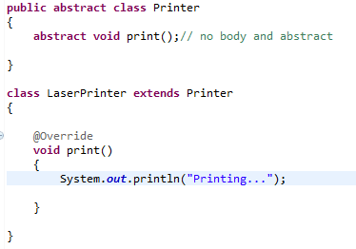
Abstract class in Java
A class that is declared as abstract is known as abstract class. It needs to be extended and its method implemented. It cannot be instantiated.
A method that is declared as abstract and does not have implementation is known as abstract method.
Rule: If there is any abstract method in a class, that class must be abstract.

